Slide 1
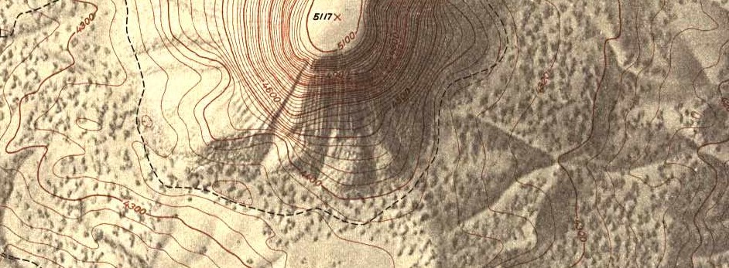
Numerical Optimization
Alexander Bronstein, Michael Bronstein
© 2008 All rights reserved. Web: tosca.cs.technion.ac.il

Slide 2
Slowest
Longest
Shortest
Maximal
Minimal
Fastest
Largest
Smallest
Common denominator: optimization problems

Slide 3

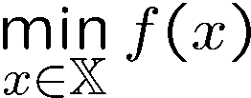





Optimization problems
Generic unconstrained minimization problem
where
Vector space is the search space
is a cost (or objective) function
A solution is the minimizer of
The value is the minimum

Slide 4




Local vs. global minimum
Find minimum by analyzing the local behavior of the cost function
Local
minimum
Global
minimum

Slide 5
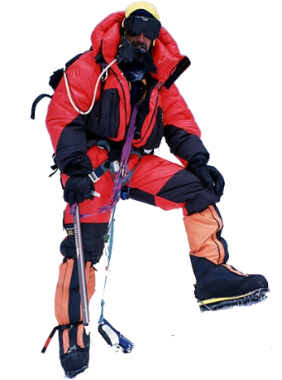
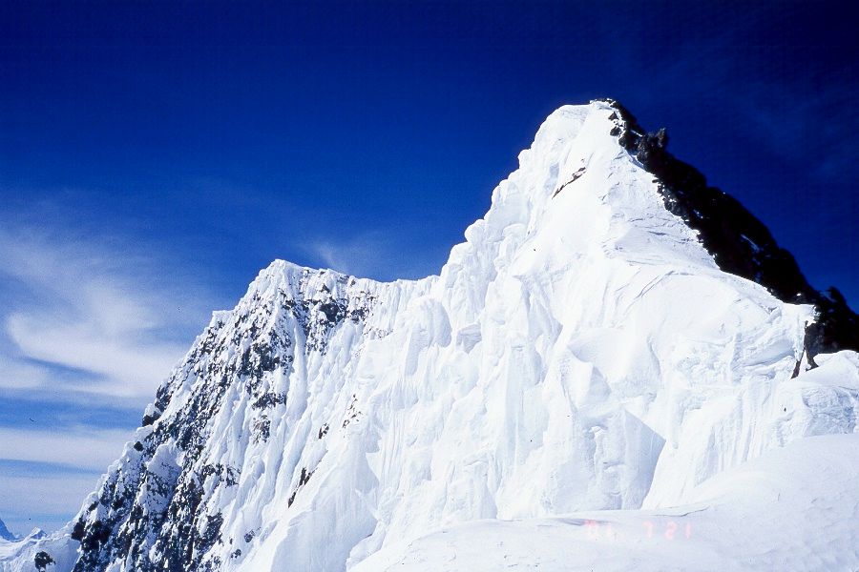
Local vs. global in real life
False summit
8,030 m
Main summit
8,047 m
Broad Peak (K3), 12th highest mountain on Earth

Slide 6







Convex functions
A function defined on a convex set is called convex if
for any and
For convex function local minimum = global minimum
Convex
Non-convex

Slide 7






One-dimensional optimality conditions
Point is the local minimizer of a -function if
.
Approximate a function around as a parabola using Taylor expansion
guarantees
the minimum at
guarantees
the parabola is convex

Slide 8


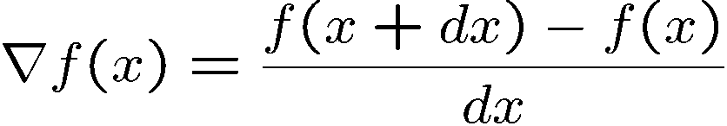
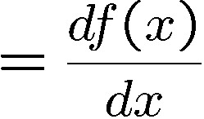

Gradient
In multidimensional case, linearization of the function according to Taylor
gives a multidimensional analogy of the derivative.
The function , denoted as , is called the gradient of
In one-dimensional case, it reduces to standard definition of derivative

Slide 9




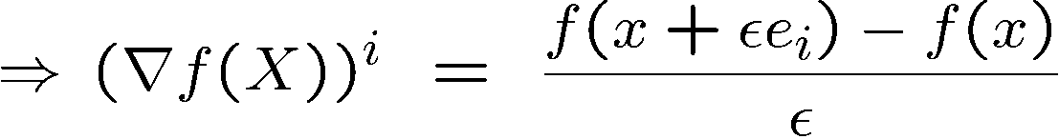
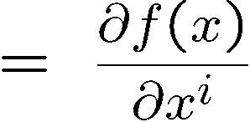

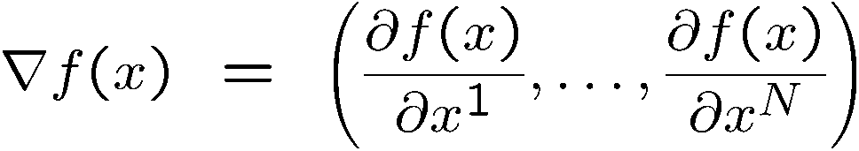
Gradient
In Euclidean space ( ), can be represented in standard basis
in the following way:
i-th place
which gives

Slide 10









Example 1: gradient of a matrix function
Given (space of real matrices) with standard inner product
Compute the gradient of the function where is
an matrix
For square matrices

Slide 11



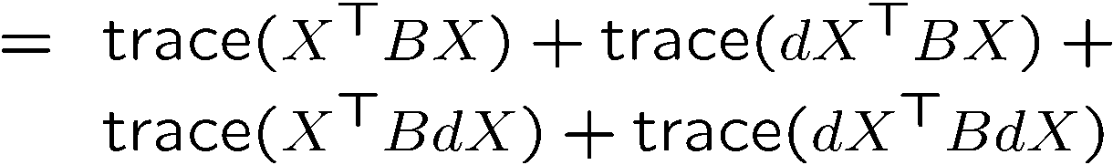


Example 2: gradient of a matrix function
Compute the gradient of the function where is
an matrix

Slide 12
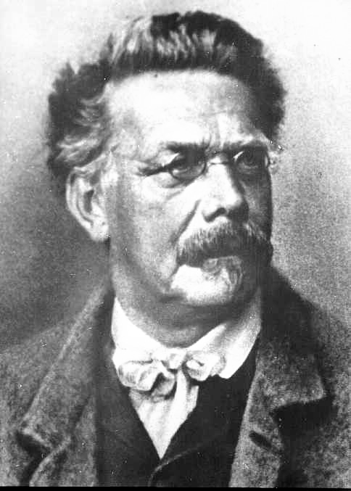


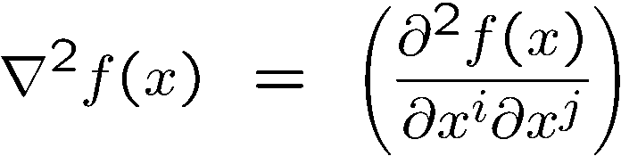
Hessian
Linearization of the gradient
gives a multidimensional analogy of the second-
order derivative.
The function , denoted as
is called the Hessian of
Ludwig Otto Hesse
(1811-1874)
In the standard basis, Hessian is a symmetric matrix of mixed second-order derivatives

Slide 13






Optimality conditions, bis
Point is the local minimizer of a -function if
.
for all , i.e., the Hessian is a positive definite
matrix (denoted )
Approximate a function around as a parabola using Taylor expansion
guarantees
the minimum at
guarantees
the parabola is convex

Slide 14

Optimization algorithms
Descent direction
Step size

Slide 15





Generic optimization algorithm
  Start with some
  Determine descent direction
  Choose step size such that
  Update iterate
  Increment iteration counter
  Solution
Until
convergence
Descent direction
Step size
Stopping criterion

Slide 16




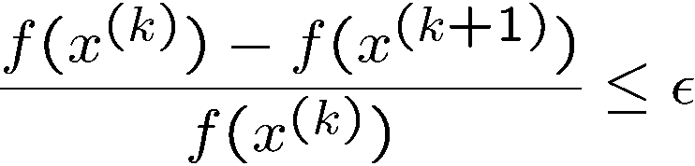
Stopping criteria
Near local minimum, (or equivalently )
Stop when gradient norm becomes small
Stop when step size becomes small
Stop when relative objective change becomes small

Slide 17
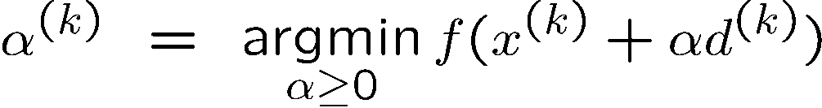
Line search
Optimal step size can be found by solving a one-dimensional optimization problem
One-dimensional optimization algorithms for finding the optimal step size
are generically called exact line search

Slide 18









Armijo [ar-mi-xo] rule
The function sufficiently decreases if
Armijo rule (Larry Armijo, 1966): start with and decrease it by
multiplying by some until the function sufficiently decreases

Slide 19
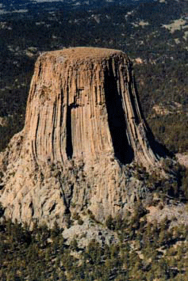
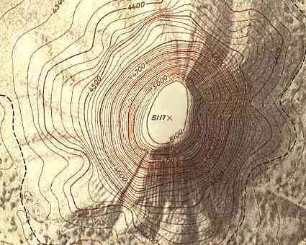
Descent direction
How to descend in the fastest way?
Go in the direction in which the height lines are the densest
Devil’s Tower
Topographic map

Slide 20

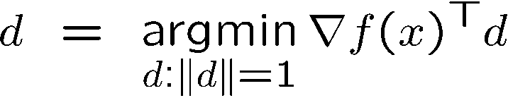

Steepest descent
Directional derivative: how much changes in the direction (negative for a descent direction)
Find a unit-length direction minimizing directional derivative

Slide 21



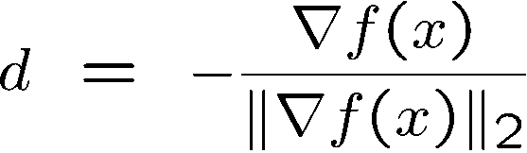
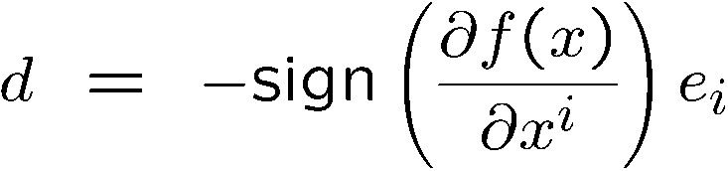
Steepest descent
L₂ norm
L₁ norm
Normalized steepest descent
Coordinate descent (coordinate axis in which descent is maximal)

Slide 22


Steepest descent algorithm
  Start with some
  Compute steepest descent direction
  Choose step size using line search
  Update iterate
  Increment iteration counter
Until
convergence

Slide 23
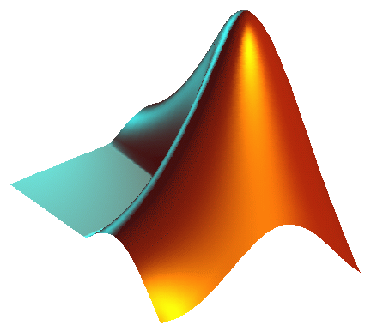
MATLAB® intermezzo
Steepest descent

Slide 24

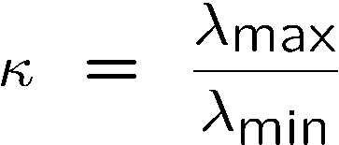
Condition number
Condition number is the ratio of maximal and minimal eigenvalues of the Hessian ,
1
1
0.5
0.5
0
0
-0.5
-0.5
-1
-1
-0.5
0
0.5
1
-1
-1
-0.5
0
0.5
1
Problem with large condition number is called ill-conditioned
Steepest descent convergence rate is slow for ill-conditioned problems

Slide 25













Q-norm
Change of
coordinates
Q-norm
L₂ norm
Function
Gradient
Descent direction

Slide 26


Preconditioning
Using Q-norm for steepest descent can be regarded as a change of coordinates, called preconditioning
Preconditioner should be chosen to improve the condition number of
the Hessian in the proximity of the solution
In system of coordinates, the Hessian at the solution is
(a dream)

Slide 27

Newton method as optimal preconditioner
Best theoretically possible preconditioner , giving descent direction
Ideal condition number
Problem: the solution is unknown in advance
Newton direction: use Hessian as a preconditioner at each iteration

Slide 28
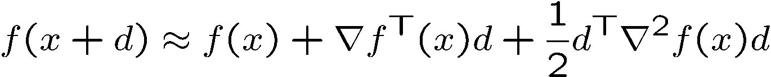

Another derivation of the Newton method
Approximate the function as a quadratic function using second-order Taylor expansion
(quadratic function in )
Close to solution the function looks like a quadratic function; the Newton method converges fast

Slide 29
Newton method
  Start with some
  Compute Newton direction
  Choose step size using line search
  Update iterate
  Increment iteration counter
Until
convergence

Slide 30
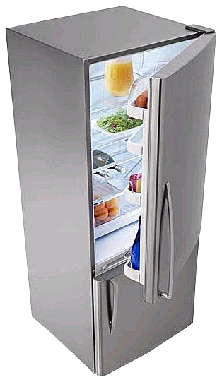
Frozen Hessian
Observation: close to the optimum, the Hessian does not change significantly
Reduce the number of Hessian inversions by keeping the Hessian from previous iterations and update it once in a few iterations
Such a method is called Newton with frozen Hessian

Slide 31
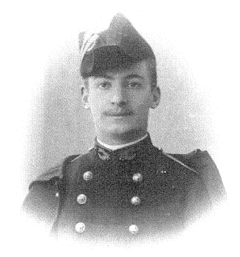





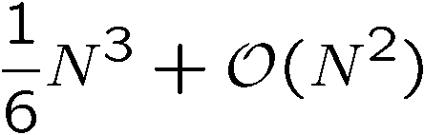
Cholesky factorization
Decompose the Hessian
where is a lower triangular matrix
Solve the Newton system
in two steps
Andre Louis Cholesky
(1875-1918)
Forward substitution
Backward substitution
Complexity: , better than straightforward matrix inversion

Slide 32

Truncated Newton
Solve the Newton system approximately
A few iterations of conjugate gradients or other algorithm for the solution of linear systems can be used
Such a method is called truncated or inexact Newton

Slide 33
Non-convex optimization
Using convex optimization methods with non-convex functions does not
guarantee global convergence!
There is no theoretical guaranteed global optimization, just heuristics
Local minimum
Global minimum
Good initialization
Multiresolution

Slide 34





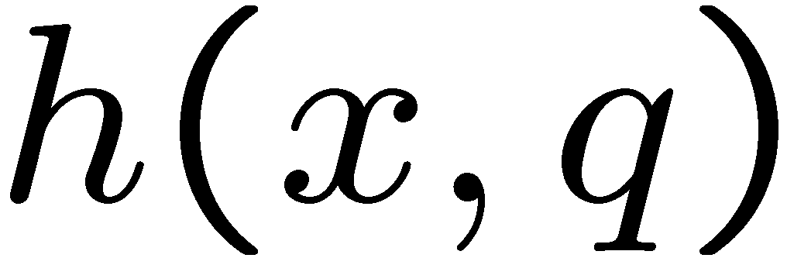
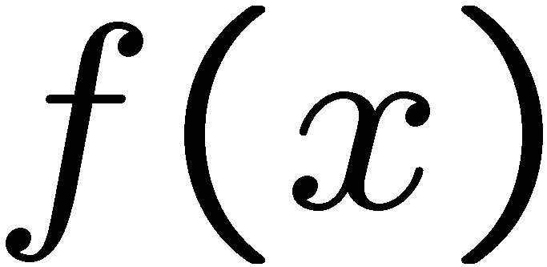

Iterative majorization
Construct a majorizing function satisfying
.
Majorizing inequality: for all
is convex or easier to optimize w.r.t.

Slide 35


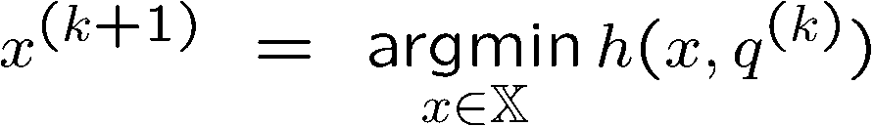


Iterative majorization
  Start with some
  Find such that
  Update iterate
  Increment iteration counter
  Solution
Until
convergence

Slide 36
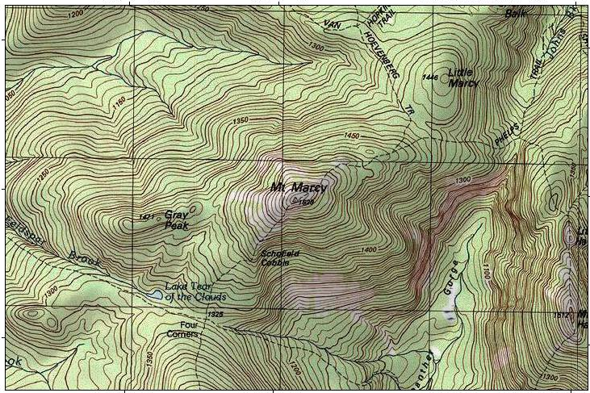

Constrained optimization
MINEFIELD
CLOSED ZONE

Slide 37
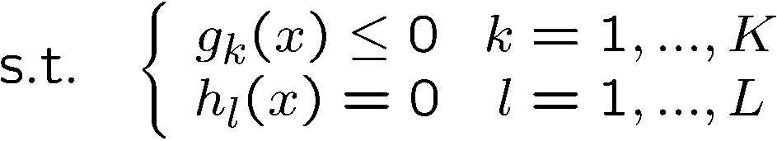



Constrained optimization problems
Generic constrained minimization problem
where
are inequality constraints
are equality constraints
A subset of the search space in which the constraints hold is called
feasible set
A point belonging to the feasible set is called a feasible solution
A minimizer of the problem may be infeasible!

Slide 38






An example
Equality constraint
Inequality constraint
Feasible set
Inequality constraint is active at point if , inactive otherwise
A point is regular if the gradients of equality constraints and of active inequality constraints are linearly independent

Slide 39
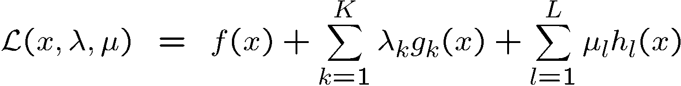



Lagrange multipliers
Main idea to solve constrained problems: arrange the objective and constraints into a single function
and minimize it as an unconstrained problem
is called Lagrangian
and are called Lagrange multipliers

Slide 40








KKT conditions
If is a regular point and a local minimum, there exist Lagrange multipliers
and such that
for all and for all
such that for active constraints and zero for
inactive constraints
Known as Karush-Kuhn-Tucker conditions
Necessary but not sufficient!

Slide 41



KKT conditions
Sufficient conditions:
If the objective is convex, the inequality constraints are convex and the equality constraints are affine, and
for all and for all
such that for active constraints and zero for
inactive constraints
then is the solution of the constrained problem (global constrained minimizer)

Slide 42



Geometric interpretation
Consider a simpler problem:
Equality constraint
The gradient of objective and constraint must line up at the solution

Slide 43
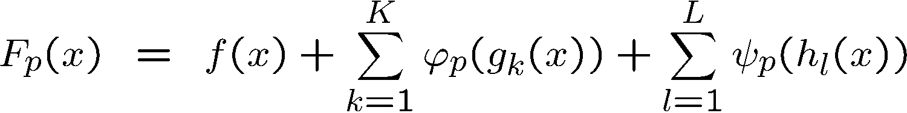



Penalty methods
Define a penalty aggregate
where and are parametric penalty functions
For larger values of the parameter , the penalty on the constraint violation
is stronger

Slide 44






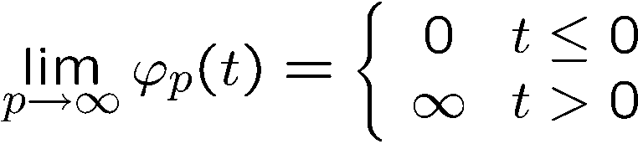
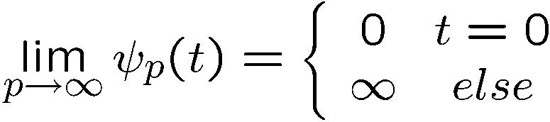
Penalty methods
Inequality penalty
Equality penalty

Slide 45

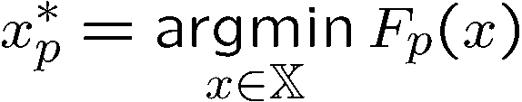

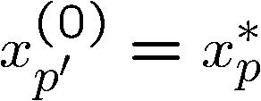


Penalty methods
  Start with some and initial value of
  Find
  by solving an unconstrained optimization
  problem initialized with
  Set
  Set
  Update
  Solution
Until
convergence

